Slide 1


Week 9
1

Slide 2
Index
2
Sr no | index
1 | Clamp assembly
Sr. no
1
2
3
4
5
Contents
Week1Sketch1
Week1Sketch2 Week1Assignment1
Week1Assignment2 Insights

Slide 3
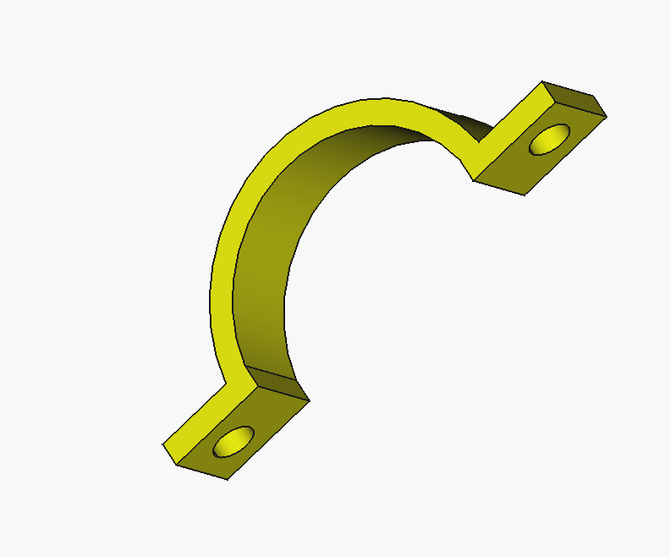
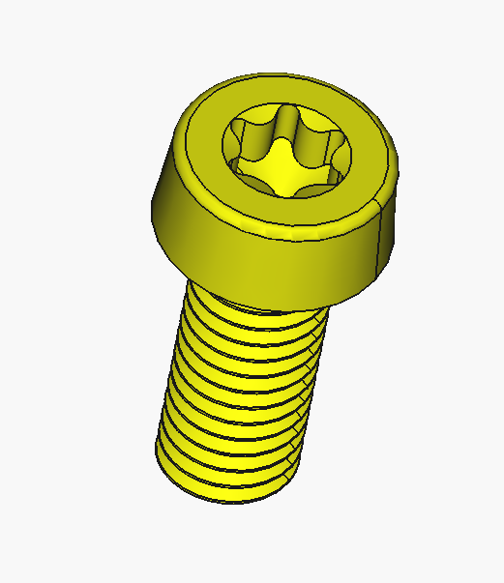

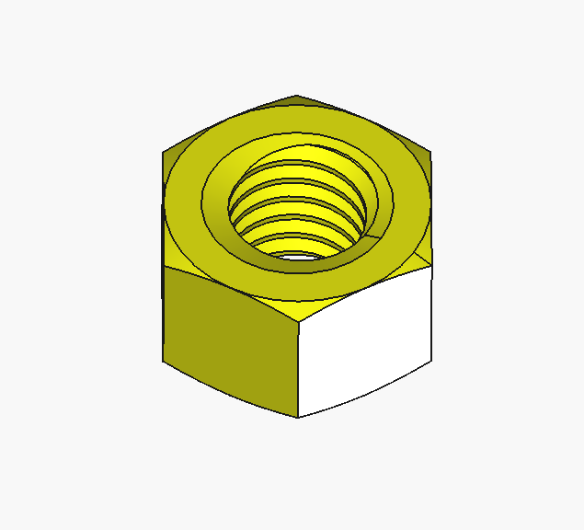
Different Parts

Slide 4

Finale assembly

Slide 5
Insights
Learned about fastener workbench in detail
Different standard size of bolt and nuts

